Slide 1
Building a conflation tool with Python
Started with streams and wetlands as they are the most common features and have more variables regarding how features are drawn from their representative points
Basic logic:
How can we leverage the limited information given to properly draw the features automatically as opposed to traditional digitizing?
Make a feature layer of the gps point data based on each unique GAI_ID (each unique feature)
This way, each feature can be looked at, drawn, and attributed individually
Run through preventative tests first, then run through main analysis

Slide 2
Preventative Analysis
To save processing time, the following checks are performed before the main section of the script is executed.
For each unique feature ID (i.e. SPA-NGP-001):
“Does each flag number occur only once (if center bank)?”
“Are there at least 2 (for stream or line features) or 3 (for wetland or polygon features) flags for the feature to be drawn from?”
“Do all features start with flag 1 and increase sequentially by 1”
If one of the above statements evaluates to False, the ID is stored in a post processing manual review list, and the feature will not be drawn.

Slide 3
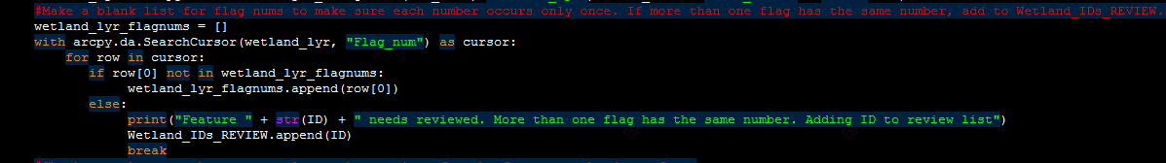
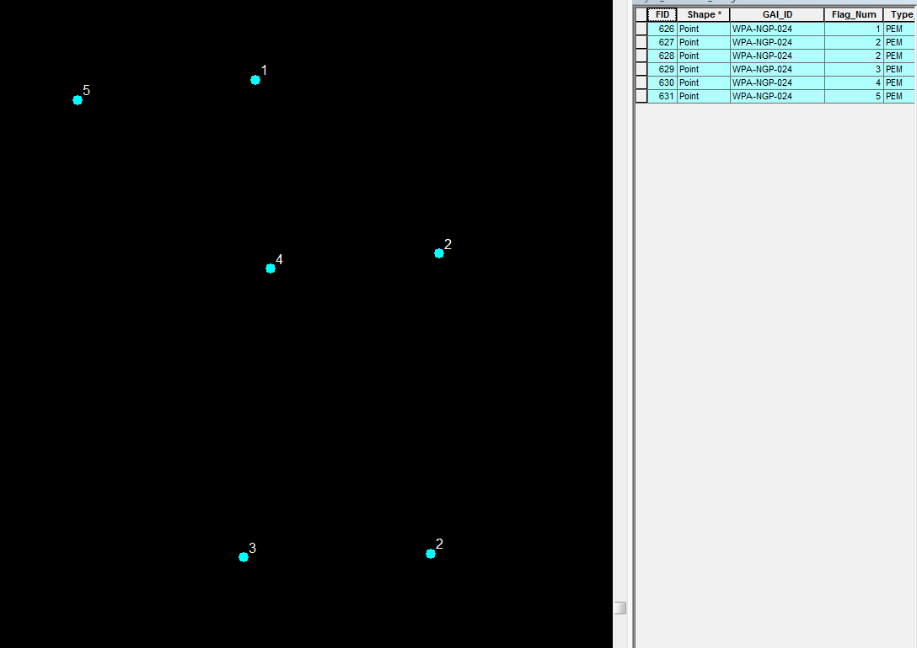
Preventative Analysis I
Does each flag number occur only once (wetland example)? This feature was not drawn as there are two flags with the same number…possibly something wrong.

Slide 4
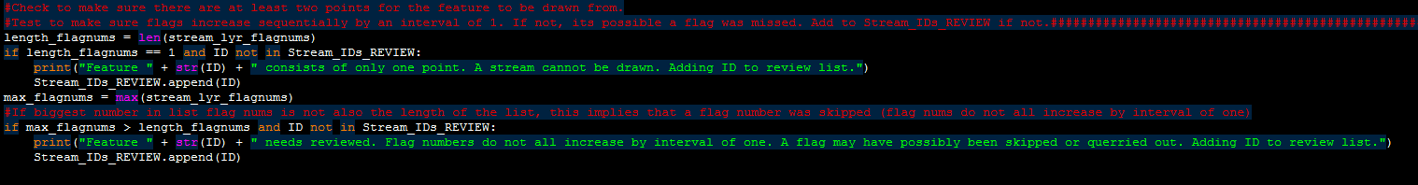
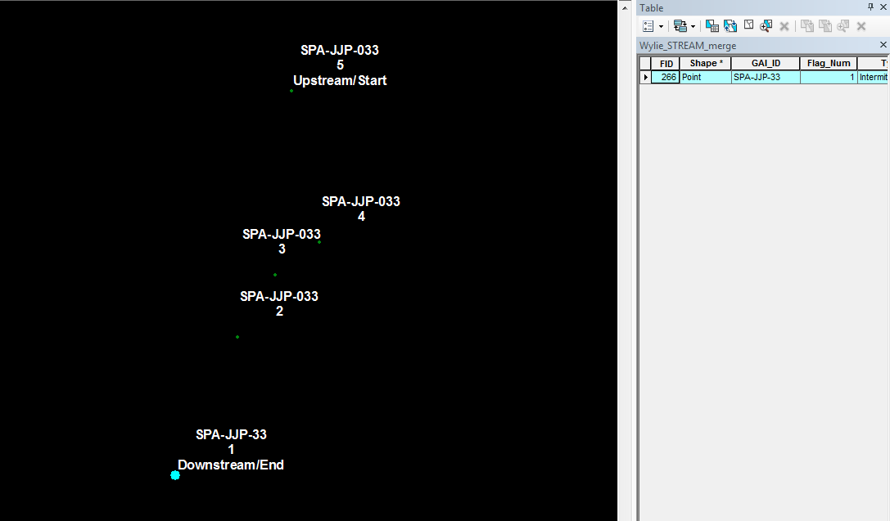
Preventative Analysis II
Are there at least 2 (for stream or line features) or 3 (for wetland or polygon features) flags for the feature to be drawn from? SPA-JJP-33 was not drawn as it is considered its own feature and there is only 1 flag (field typo).

Slide 5
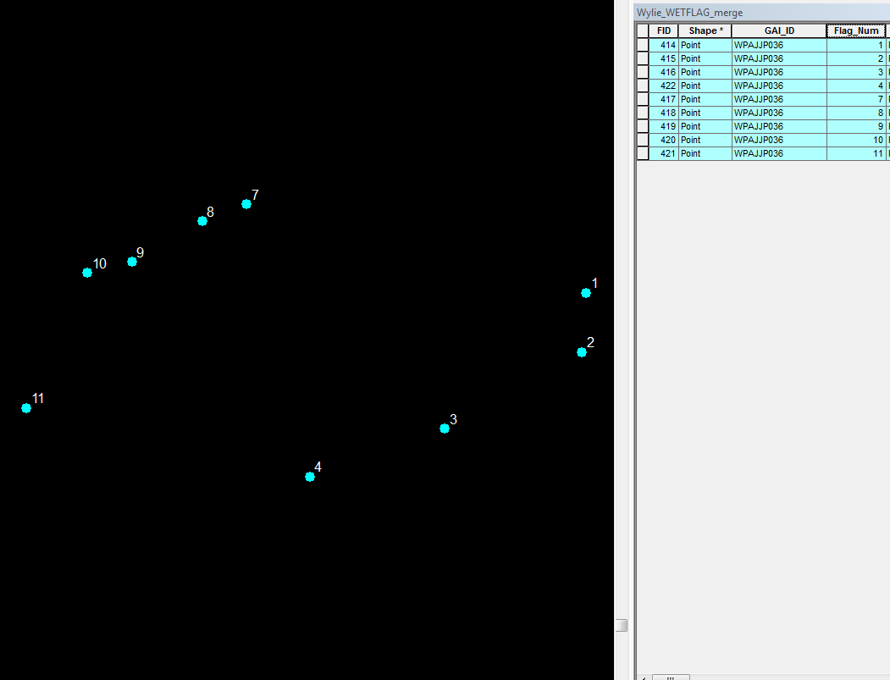
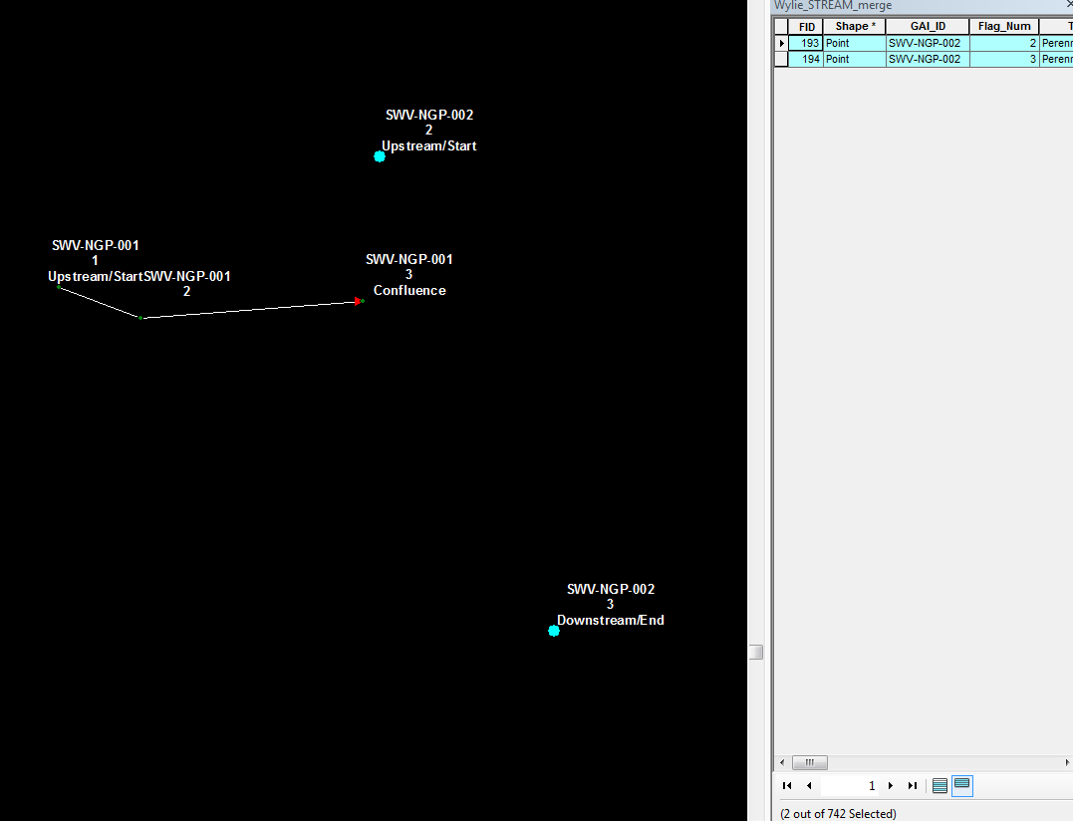
Preventative Analysis III
Do all flags start at 1 and increase sequentially by one? Left example numerically skips flags. Right example missing flag 1.

Slide 6
Wetland Workflow
Create a feature layer of the wetland points for each unique GAI_ID: wetland_lyr
For each unique wetland_lyr:
Draw the outline of the wetland using PointsToLine in order of flag number (close line): wetland_outline
Make a polygon from wetland_outline using FeatureToPolygon: wetland
Get a feature count of the derived feature wetland.
If the feature count >= 2, this implies that the feature intersects itself and it must be drawn manually. It will be added to the post processing review list.
If the feature count is not >=2,
Using a combination of Search and Update cursors, update the attributes of wetland with the attributes of wetland_lyr
Special case for “wetland_type” and “open end”. Skip to slide 21 for how attribute transfer works

Slide 7
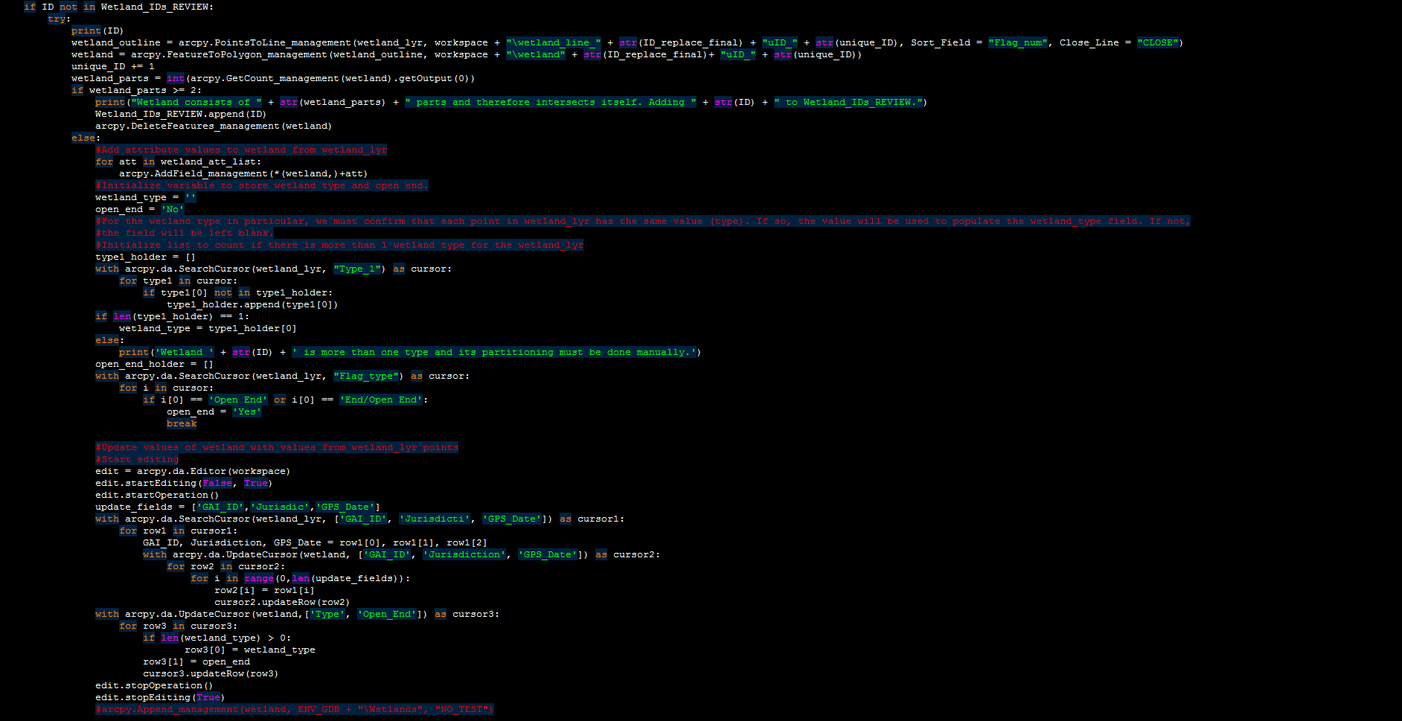
Main section of Wetland Script (The comments aren’t likely enough to explain every line, this is just for temporary reference).

Slide 8
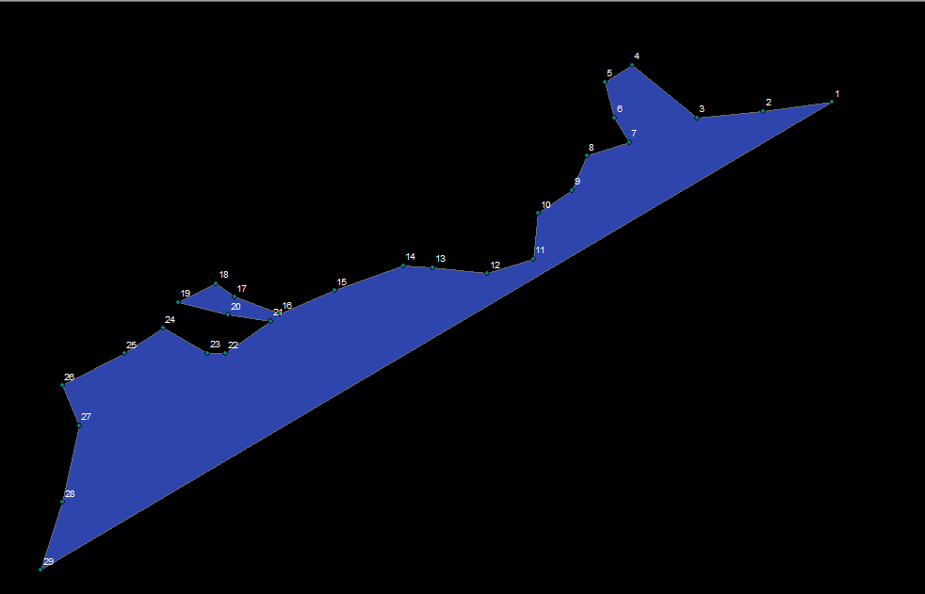
Wetland Workflow: Successfully drawn and attributed

Slide 9
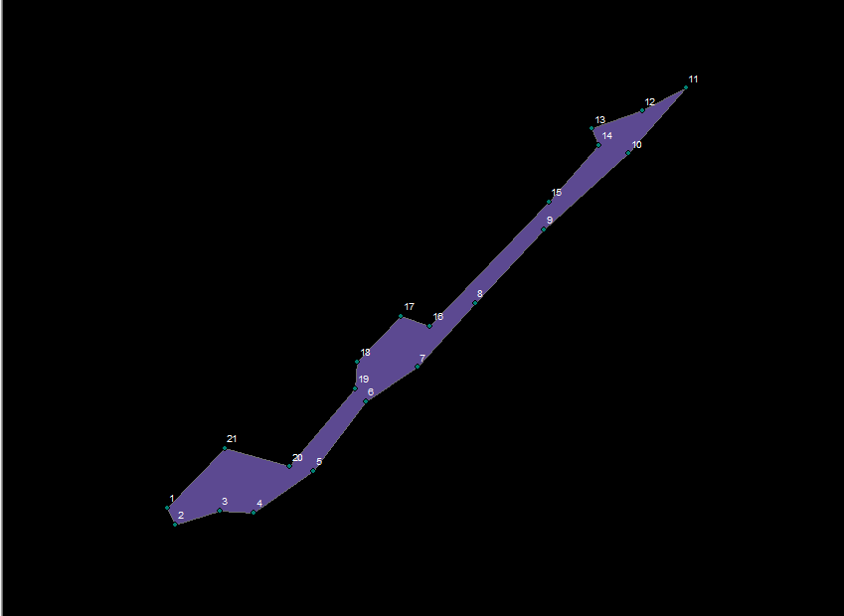
Wetland Workflow: Successfully drawn and attributed

Slide 10
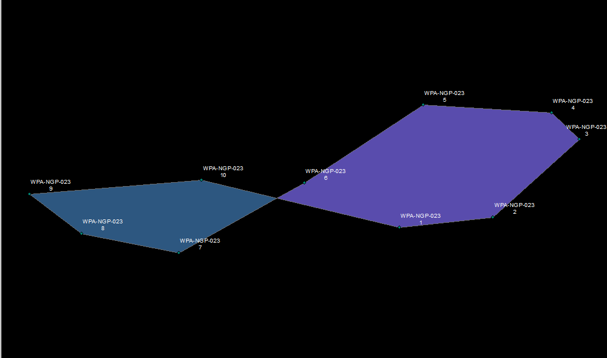
Wetland Workflow: Intersects itself and therefore will be deleted and have its GAI_ID added to a manual review list.

Slide 11
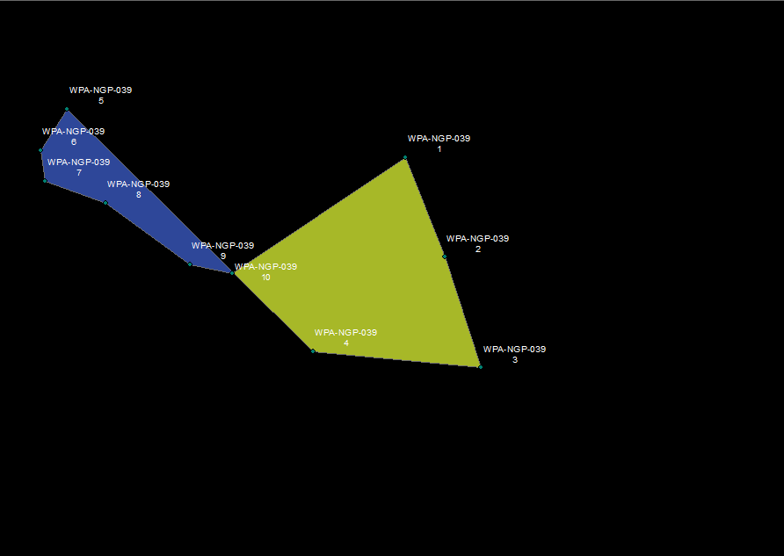
Wetland Workflow: Intersects itself and therefore will be deleted and have its GAI_ID added to a manual review list.

Slide 12
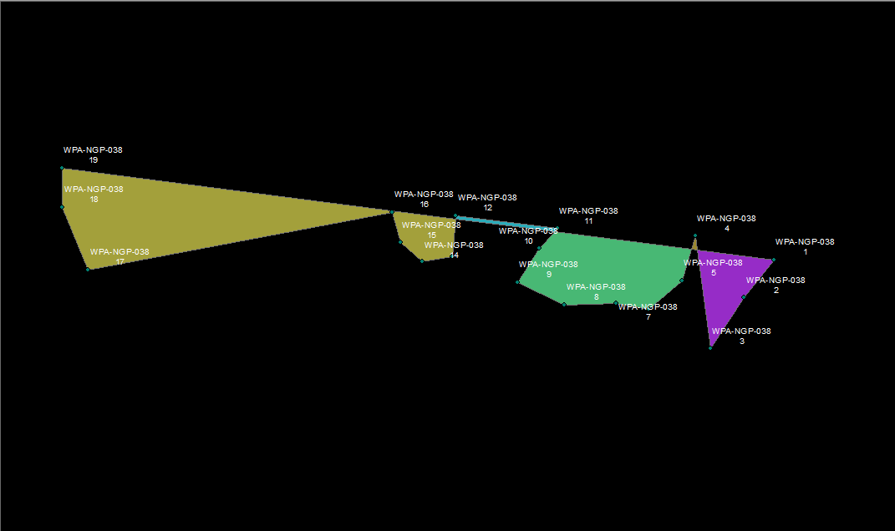
Wetland Workflow: Intersects itself and therefore will be deleted and have its GAI_ID added to a manual review list.

Slide 13
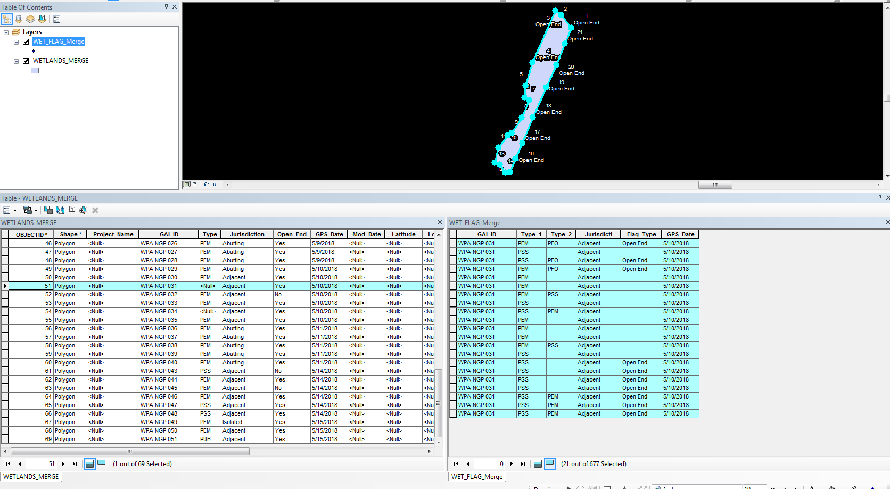
Wetland Workflow: Wetlands that need parsing (>1 value type in ‘Type_1’ field) but evaluate fine otherwise will be drawn and attributed, but will have the attribute ‘Type’ left blank for manual review (this will be printed to the console).

Slide 14
Open Ends
Determine if wetland is open ended. If so,
Create layer of just open end flags from wetland points of wetland
Split wetland into its lines by vertices such that each line will have only two vertices (its first and last point).
For each line:
Select by location the open end flags that intersect line
Get count of open end flags
If count of open end flags <2:
Line dismissed as non open end
Else:
Line added to open ends

Slide 15
Stream Workflow
Create a feature layer of the stream flags for each unique GAI_ID: stream_lyr
Draw stream/line from stream_lyr by Bank_Side in order of Flag_nums: stream_line
Create a point feature on the start and end point of stream_line (this will create a set of points for each line): start_point, end_point
Determine if there are one or two lines (banks)
Evaluating stream_line (one line at a time if there are two), select by location the stream flags that are identical to start_point, end_point
Get the value of the “Flag_type” field of the selected stream flag. If the value of the stream flag coincident with the end_point is “Upstream/Start” or “Headcut” OR if the value of the stream flag coincident with the start_point is “Downstream/End” or “Confluence”, the stream has been drawn in the wrong direction based on these logical indicators.
If the line (drawn in the order of the flag numbers) is determined to be drawn in the wrong direction, this line will be deleted. A new field will be added to stream_lyr named “Flag_neg”. It will be calculated as “Flag_num*-1”. Since the points to line tool draws lines in order of least to greatest, following this field will draw the line in the opposite direction as each value is the inverse of the original.
Setting the logic in this manner prevents a “False” evaluation arising from an end point not attributed “down stream” or a start point not attributed “up stream” when the attribution is left blank (as long as we know one side, the other can be inferred).

Slide 16
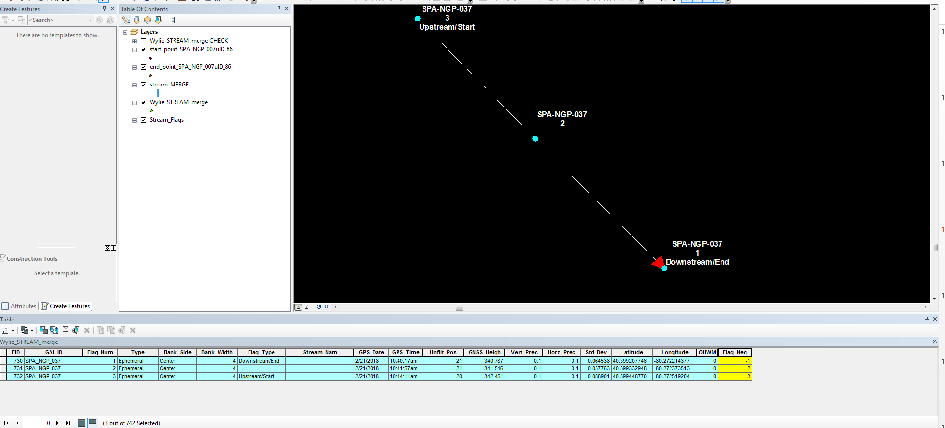
The stream here was originally drawn flowing north by the Flag_num field. Once the stream was drawn, points were created on it’s start and end locations (flags 1 and 3 respectively). The Flag_Type value for the flags coincident with the start and end points were then evaluated. Since the start point was on a “Downstream/End” flag and the end point was on an “Upstream/Start” flag, this evaluated such that the field highlighted in yellow was created, and the stream was redrawn in the order of this field from least to greatest, resulting in a line drawn in the opposite direction.
Stream Workflow (Basic example): Drawing a stream in the appropriate direction using flag type

Slide 17
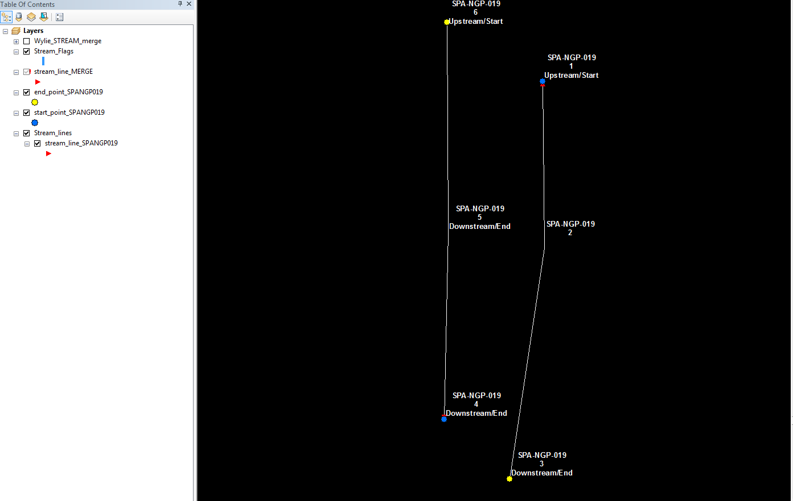
(True direction is south) Before having the script evaluate bank sides individually, this stream was drawn as shown. The left bank (right side of screen) was taken numerically in the downstream direction, but the right bank was not. A false flag arose when the end point of the “single” stream (flag 6) was associated with an Upstream/Start flag. Before the script was changed to evaluate sides individually, this false flag switched the directions of both banks rather than just the right, resulting in the right bank in the appropriate direction but the left bank in the wrong direction.
Stream Workflow (Complex example): Drawing a stream in the appropriate direction using flag type--Before

Slide 18
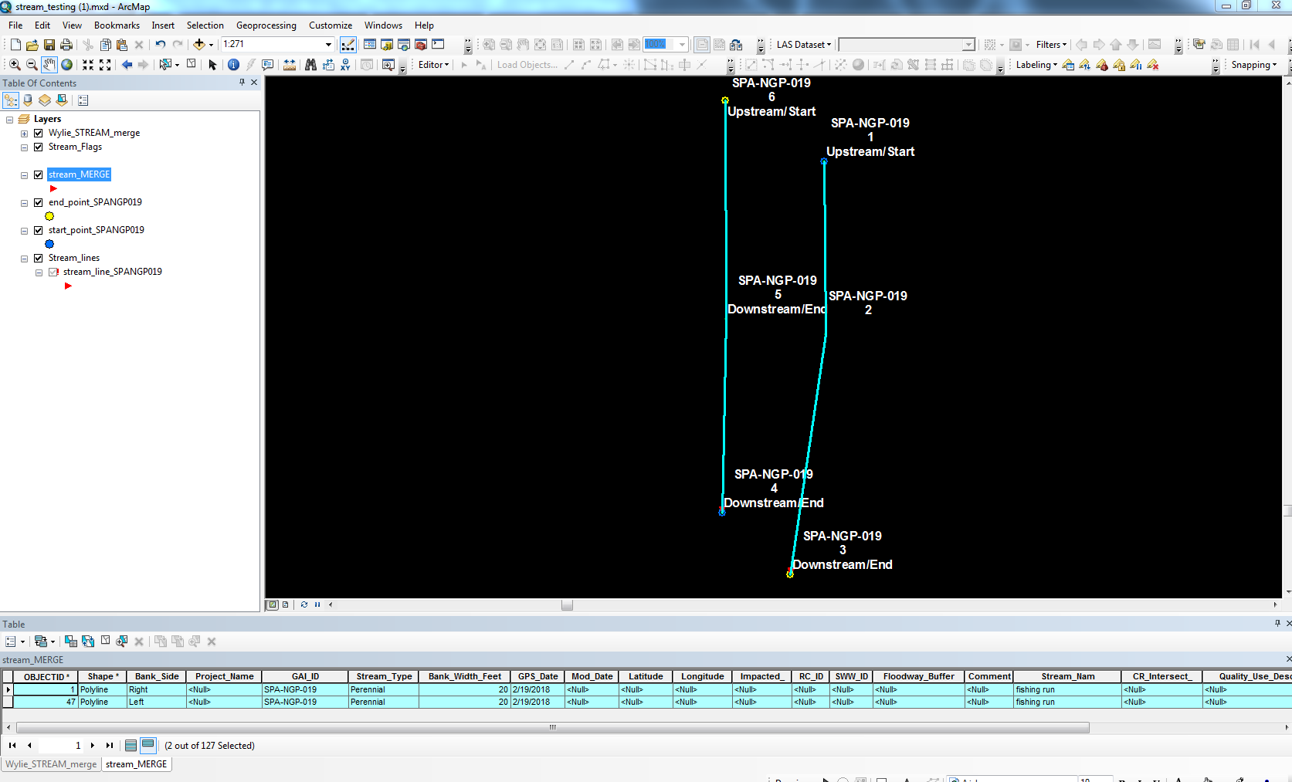
Stream Workflow (Complex example): Drawing a stream in the appropriate direction using flag type--After
Once the script was modified to look at stream direction by individual bank, the stream was correctly drawn as shown.
This showcases some of the complex scenarios that have been accounted for.

Slide 19
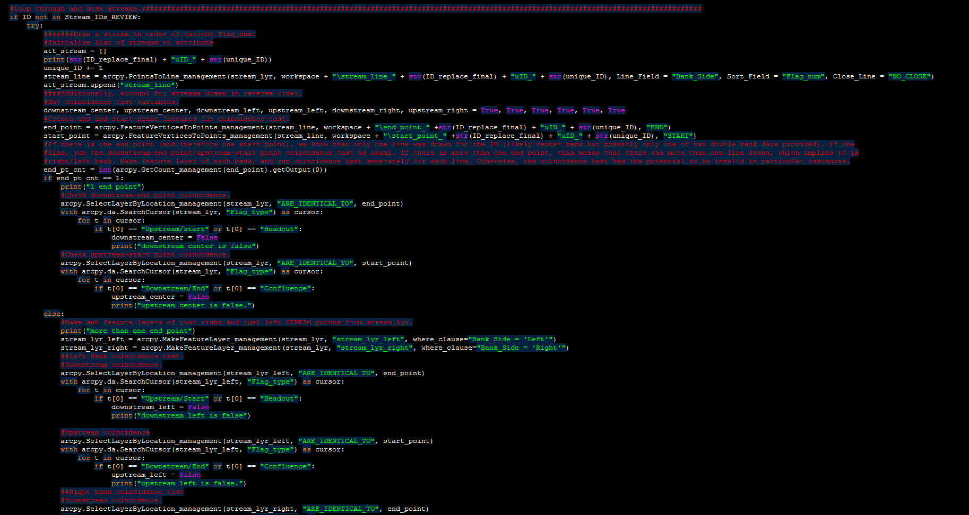
Main sections of Stream Script (The comments aren’t likely enough to explain every line, this is just for temporary reference).

Slide 20
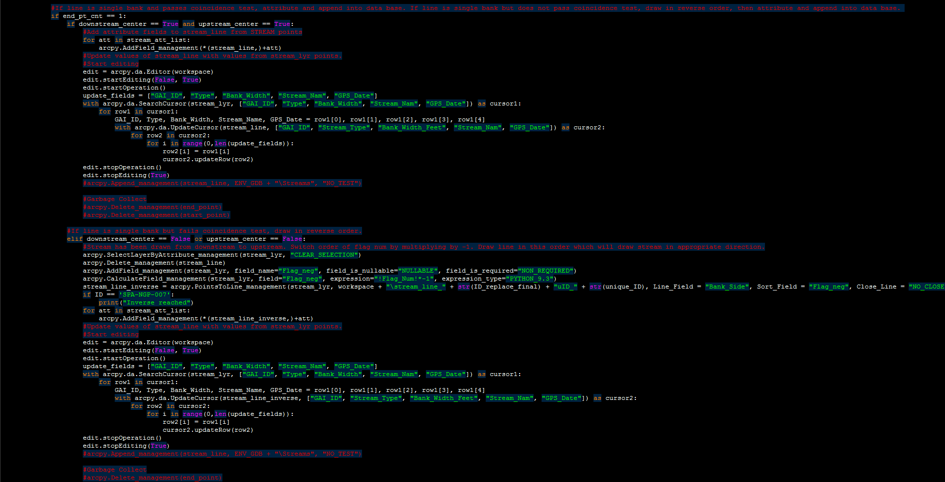

Slide 21
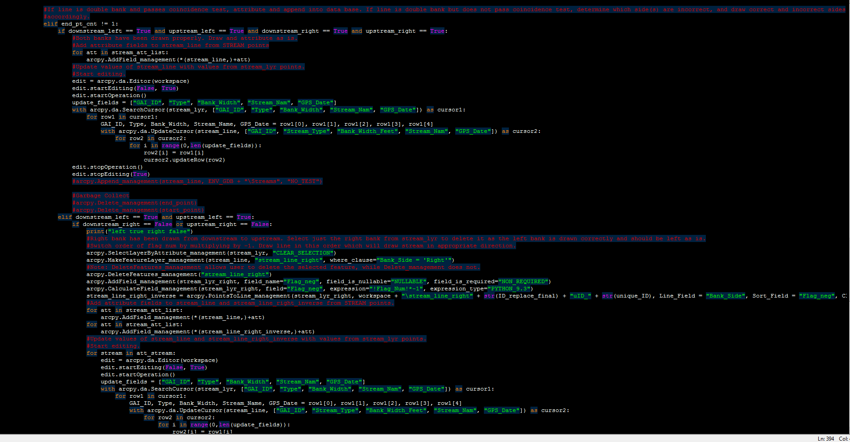

Slide 22

Attribute Transfer
Initialize a list of tuples of fields to be added to the derived feature.
The following code iterates through the above list and adds each field and its associated parameters to the derived feature.

Slide 23
Attribute Transfer
Align the values from the “from” layer (feature layer of gps data being assessed) and the “to” feature (derived feature) by the following:
Create a Search Cursor on the feature layer being assessed to queue the values of the fields requiring transfer to the derived feature
Create a list of fields to have their attributes transferred. The length of this list will be used to index the transfer loop
Create an Update Cursor on the derived feature to queue the empty fields receiving attributes from the corresponding fields queued in the “from” feature layer.
Iterate through “from” layer and “to” feature(row1 and row2, respectively) and set row2[currently empty first field to be populated] = row1[value of first field to be sent to the empty row2 field]

Slide 24
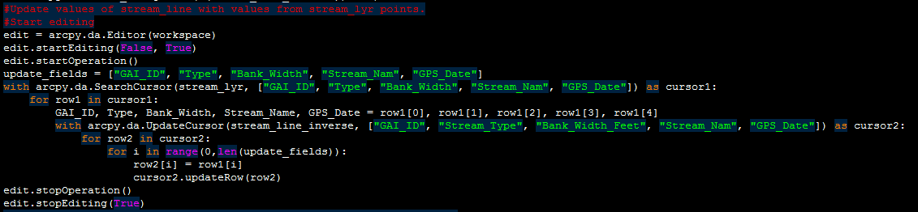
Attribute Transfer
In the first iteration:
Row2[0] is the empty field of the “GAI_ID” of the derived feature
Row1[0] is the populated field of the “GAI_ID” of the feature layer being assessed (gps feature flag)
“Row2[0] = row1[0]” sets the “GAI_ID” field of the derived feature, and the .updateRow method applies the transfer
The second iteration would be:
Row2[1] is the empty field of the “Stream_Type” of the derived feature
Row1[1] is the populated field of the “Type” of the feature layer being assessed

Slide 25
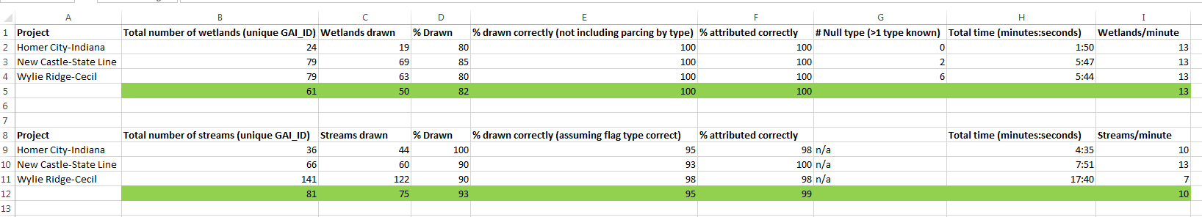
Results on 3 different sets of data
Wetlands
With the data as is, on average, the script is able to draw 82% of the wetlands given with 100% accuracy with the exception of parsing them by type. As state previously, the wetlands that evaluate fine otherwise are still drawn and attributed but the Type field is left blank (this is printed to the console).
With the exception of multi-type wetlands, 100% of the wetlands were attributed correctly.
It averages 13 wetlands per minute, which is significantly faster than manually drawing and attributing them, and may still be more efficient given the extra QC that comes with automating processes.
Streams
With the data as is, on average, the script is able to draw 93% of the streams given with 95% of them being drawn correctly (assuming flag type is correct) and 99% of them being attributed correctly.
The streams are a little more complex than the wetlands (the script is longer), but the average speed is still 10 streams per minute which is still significantly faster than manually drawing and attributing them.

Slide 26
Pros VS Cons
Pros:
The most obvious advantage is how quickly features can be drawn and attributed compared to doing them manually. This in itself may outweigh a lot of the disadvantages.
Reducing human error: In the past, I have found myself drawing a lot of data on, for example, 8/04/2018. After doing that for a while and moving on to data from 8/05, I was still entering 8/04 as I had been doing that for many features for a while, and I had to go back and find the mistakes. This method eliminates this possibility.
The benefits scale greatly as the amount of data increases. This would allow GAI to have multiple teams on multiple projects on the same day in the field collecting data without requiring an increase of corresponding magnitude in hours spent by GIS staff integrating the data.
Cons:
Instances such as leaving the “Upstream/Start” attribute on for all stream points etc. Even with the dedicated fields that the logic of the script is based upon, this poses a concern (especially instances not caught by the “try-except” block).
Not typically as practical for surveys that extend preexisting features (AR study or modified study area).
Often times, a wetland extension will only consist of 2 points, or a stream extension will only consist of 1 point. Neither of these will be able to be drawn by the script as they are being treated as different features.
Even if the extension can be drawn, it will have to be manually merged into the preexisting feature, negating some of the benefits implicit of creating a new feature by automation.
Ideally, field data is to be drawn and verified on a daily (or once every few days) basis as the features will be more freshly recalled by the field team. Given the infrequency of working on 5, 10, or even 20 (not sure if 20 has ever even happened before) gps files at a time, the substantial benefit of automated vs manual on a large amount of data may never be realized. Even so, on a daily basis, there still may be room for this method.
Miscellaneous things such as a single stream having flags with different widths (only one width could be transferred to the derived features).

Slide 27
Final Thoughts
Currently, the data is a little messy. Things like having a “Flag Type” populated for streams (an integral part of the script’s process) is in a way a luxury, and is not always added in the field. It is also my understanding that, given the nature of the gps units we currently use, it is very easy to unintentionally leave parameters on for multiple points, and it is a hassle to go back and fix them. For now, GIS staff can often easily discern if there was a mistake and what was originally intended.
Despite this, the script still runs with impressive accuracy and speed. My hope is that with the new tablets that will be introduced to field staff, simple things like adding a flag type on the ends of streams or being able to see that the culvert point is still turned on is easier to enter, notice, and modify before sending to GIS.
I am not aware of what possibilities the tablets will bring, and I am not aware even if anything in this presentation will still be applicable once the tablets are fully integrated into our workflow. But, given the numbers, I feel that this should be explored more thoroughly.
I do have a few more concepts I have thought of regarding catching more flaws in the script, but the main flaws have been worked out, and I would like to leave this project as is until it can be determined if it is worth continuing.
The main question that this all comes down to is “Is the speed and accuracy of digitizing and attributing field data automatically with an additional QC actually more efficient across the board than digitizing and attributing manually as this acts, in a sense, as a QC in itself?”

